Slide 1
Kontrol
Muhammad Ary Murti

Slide 2
Pengertian (1)
KONTROL
➔ Kendali,
OTOMATIS
➔ Tanpa campur tangan manusia

Slide 3
Pengertian (2)
Plant ➔ Objek yang akan dikontrol
Actuator ➔ Suatu perangkat yang memberikan aksi kepada plant
Controller ➔ pengontrol/pengendali
Controlled Variable ➔ kuantiti atau kondisi yang terukur dan terkontrol
Manipulated Variable ➔ kuantiti atau kondisi yang dapat berubah oleh pengaruh pengontrol

Slide 4
Pengertian (3)
Process ➔ Suatu operasi yang akan dikontrol
System ➔ Kombinasi dari beberapa komponen yang berkerja secara bersama dalam mencapai suatu tujuan.
Disturbance ➔ Suatu sinyal yang mempengaruhi keluaran dari sistem yang kemunculannya tidak diinginkan.
Feedback ➔ Umpan balik, memasukkan sinyal keluaran sistem ke bagian sebelumnya atau bagian awal proses dari suatu sistem.

Slide 5
Pengertian (4)
Sensor ➔ komponen untuk mengukur suatu kuantiti atau kondisi
Loop ➔ suatu aliran proses
Open loop ➔ aliran yang tidak memiliki feedback
Close loop ➔ aliran proses yang memiliki feedback. ➔ Kontrol Otomatis

Slide 6
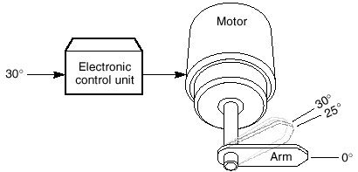
Open Loop

Slide 7
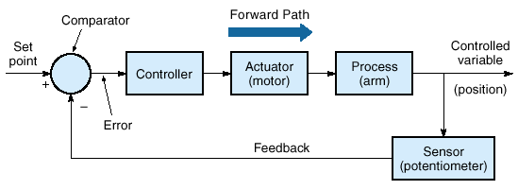
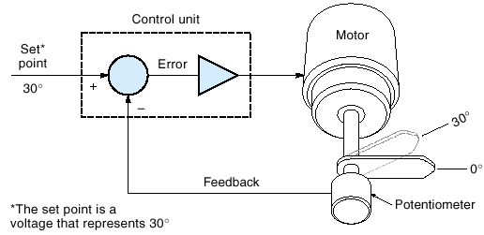
Closed Loop

Slide 8
Sinyal pada sistem kontrol

Slide 9
Historical Review (1)
200 SM → Jam air dgn cara mengatur level air oleh pelampung agar tetesan airnya konstan.
Cornelis Drebbel (1572-1633) → pengatur suhu dalam ruangan dengan cara mengalirkan udara panas
William Henry (1729-786) → pengatur suhumenggunakan peredam FLUE yang dimanipulasi secara otomatis untuk mengendalikan pengapian.
Denis Papi (1674-1712), Robert Delap (1799), Matthew Murray (1799) → pengatur tekanan mesin uap
Matthew Boulton dan James Watt (1788) → kendali kecepatan pada kincir angin dan mesin uap.
➔Gorvernor Sentrifugal

Slide 10
Historical Review (2)
Minorsky (1922) → Penggunaan persamaan diferensial untuk menunjukkan kestabilan sistem.
Nyquist (1932) → penentuan kestabilan suatu sistem closed loop dengan respon tunak dari input sinusoidal pada bagian open loop sistem.
1940 → frekuensi respon untuk keperluan desain sistem kontrol closed loop yang linier
1940-1950 → root locus

Slide 11
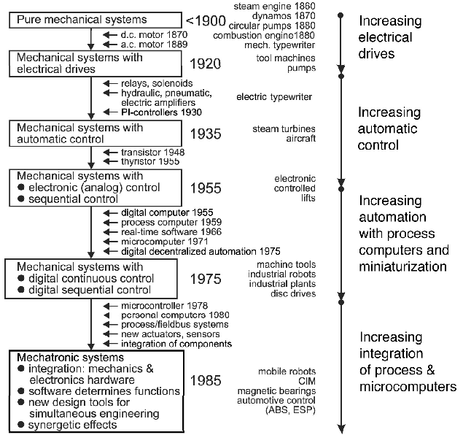

Slide 12
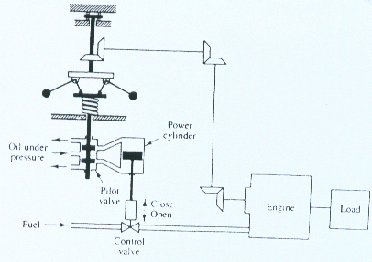

Slide 13
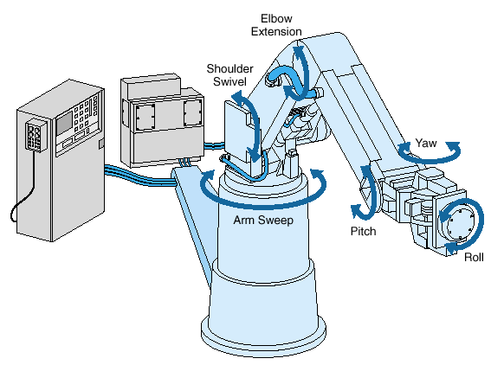

Slide 14
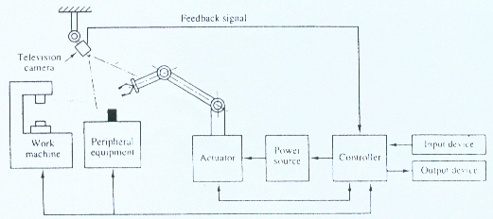

Slide 15
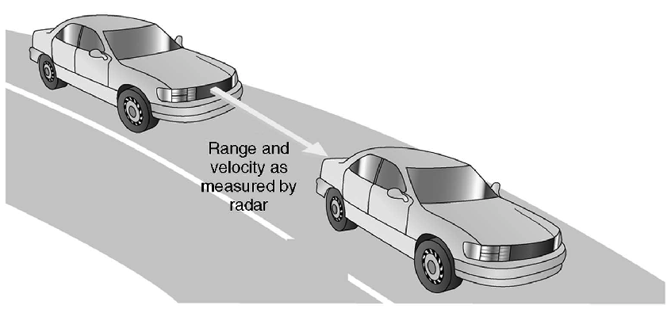

Slide 16
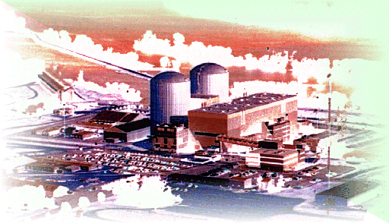

Slide 17
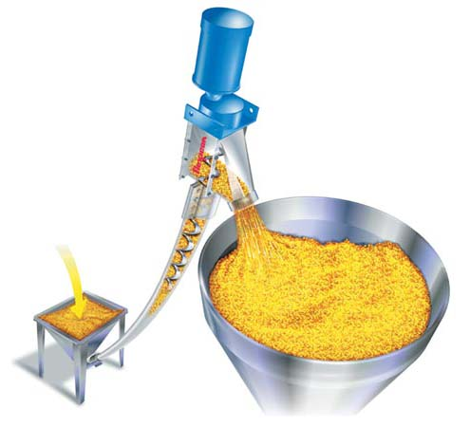

Slide 18
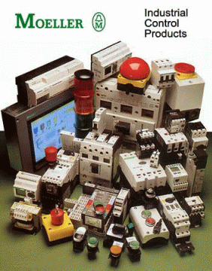
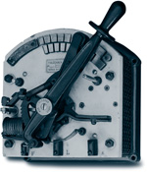

Slide 19
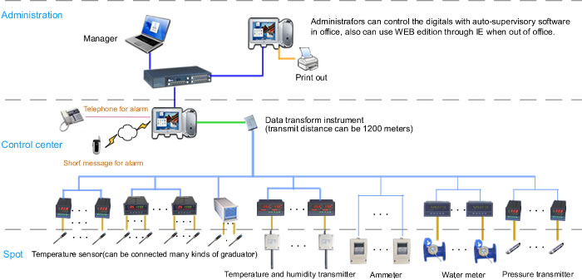

Slide 20
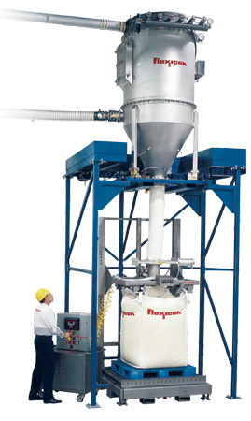

Slide 21
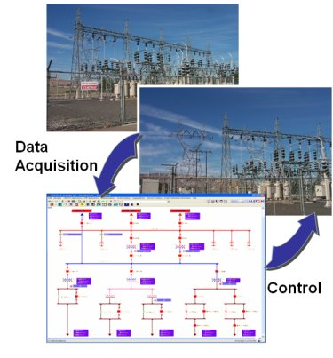

Slide 22
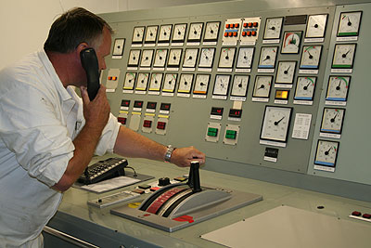

Slide 23
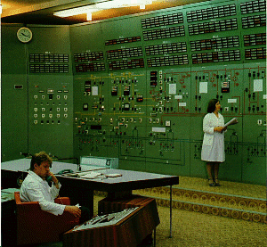

Slide 24
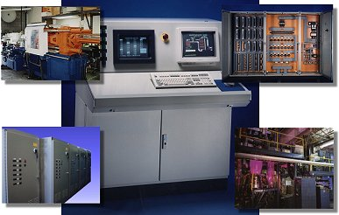

Slide 25
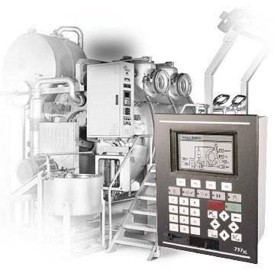

Slide 26
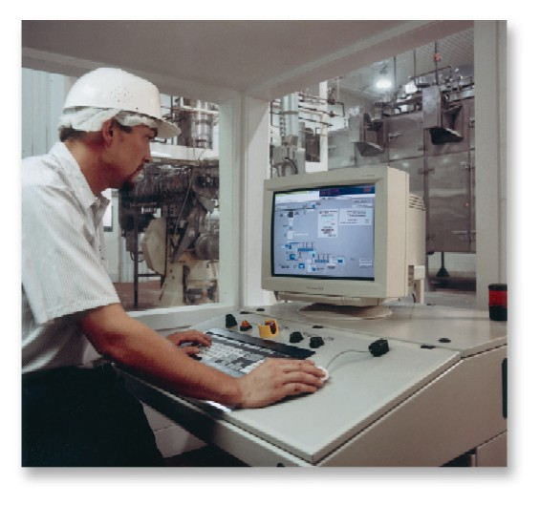

Slide 27
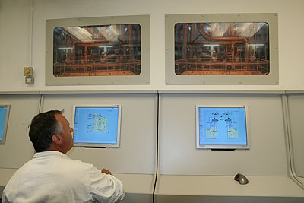

Slide 28
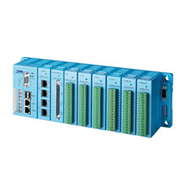
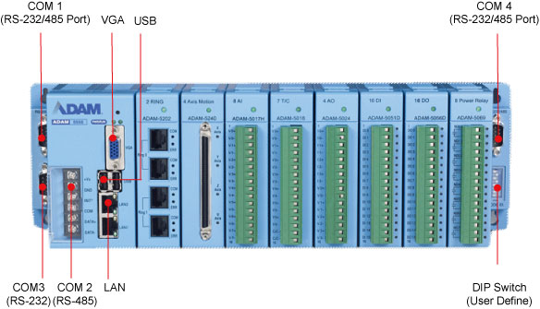

Slide 29
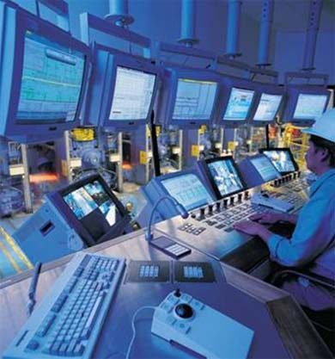

Slide 30
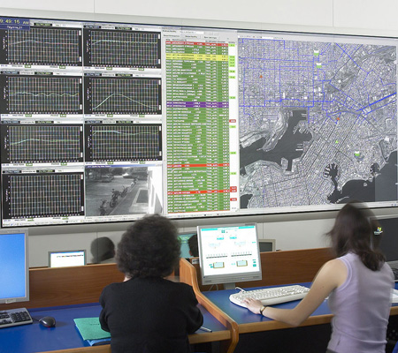

Slide 31
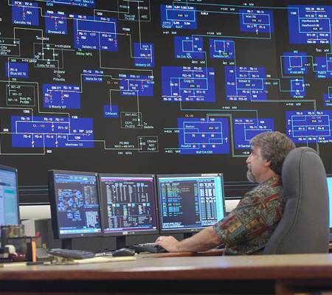

Slide 32
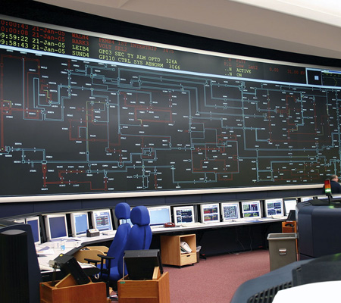

Slide 33
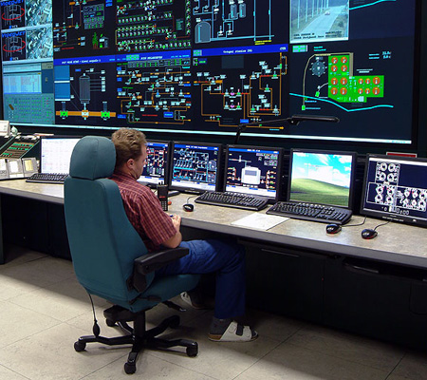

Slide 34
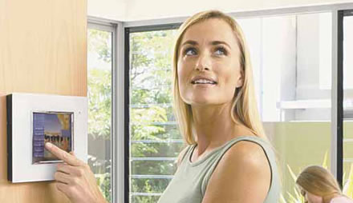

Slide 35
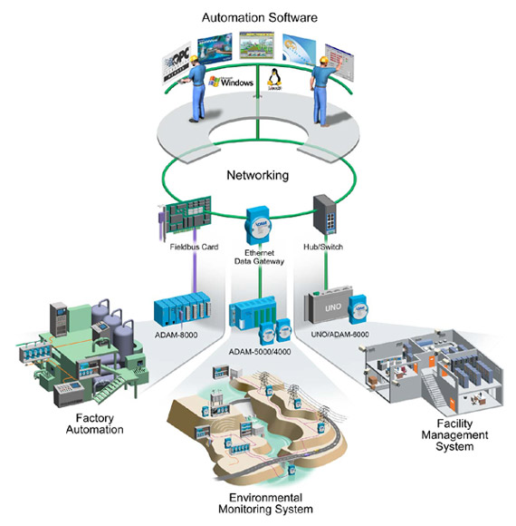

Slide 36
Three trends in particular will determine developments in industry : trade, logistics and building systems in the coming years
the further penetration of information and communications technologies into these sectors;
the expansion of global networks;
and customer demand for tailor-made products.
The illustration on this page offers an example of this phenomenon with respect to the development, production and delivery of a piece of "intelligent apparel" by a fictitious company known as "Intelligent Clothing" (IQ-C). Integrated into the clothing are a mini-computer, cell phone, health-check system, and a powerpack with antenna for operating the devices.

Slide 37
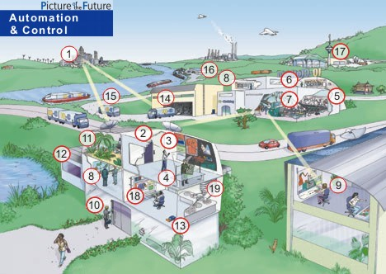

Slide 38
1 Customers formulate their special requirements and pass them on to the development engineers at IQ-C (3).

Slide 39
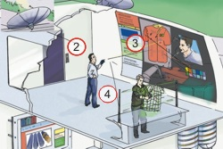
2-4Digital Engineering: The virtual and the real world are merging. In development centers scattered around the world (2) engineers are working closely together with individual customers, using computers and 3D model design products (3) planning manufacturing processes (4) and simulating the interaction between product and processes. Procedures like these allow for rapid development of marketable products.

Slide 40
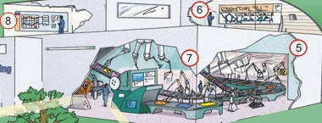
5-8 Production: The factory of the future will rely on integrated systems, automation, and on the comprehensive networking of everything from sensors and robots (7) on the assembly line (5), (which will display a high level of decentralized intelligence). Company managers (8) will be capable of accessing all relevant information at any time and from any location. Control stations will provide personnel with all the specialized data they need (6), to make the right decisions and ensure the safe and secure operation of plant systems. Developers, suppliers and customers will be digitally integrated into the process, as will specialized experts who use computers to optimize systems with respect to productivity and lifecycle costs, for example.

Slide 41
9Production services: New types of service providers will also be incorporated into the networked business processes. These firms will assume responsibility for providing comprehensive service throughout the entire lifecycle of a product. For example, powerful IT tools will be available for conducting fault diagnoses and servicing factory units and equipment. Such tools will enable experts located in various service centers to conduct remote maintenance activities around the clock (9). Condition monitoring systems will check up on plant equipment online, making it possible to conduct preventive maintenance.

Slide 42
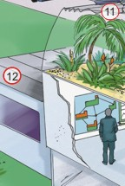
10-13Intelligent buildings: Intelligent buildings will be equipped with numerous networked systems linked to a service provider. The scope of this kind of networking will range from biometric security systems (e.g. fingerprint or face recognition units at building entrances 10), and heating, air conditioning and ventilation systems (11), all the way to automatic building-facade controls (12), fire alarm systems, and intelligent cameras that will forward to the central security office only those images that seem suspicious. Built-in system intelligence, the ability of systems to communicate, and the networking of systems will not only provide customers with greater comfort and security but also open up cost-saving potential - in the area of energy management, for example. Like the factories of the future, the buildings of the future will also increasingly be manned by robots that operate autonomously (13), and are able to organize their own work activities (e.g., cleaning operations).

Slide 43
14-17Individual logistics: The digital networking of all processes along the value chain will link manufacturers, suppliers and customers, while also leading to improved business processes. E-business also requires e-logistic systems marked by an increasingly individualized and more rapid distribution of goods, whether these are transported by truck (15), train, ship (16) or plane (17). Together with intelligent labels that can be read via radio, directly from individual pieces of cargo (14), the satellite location positioning of vehicles and containers will make possible precise tracking of products - from their creation all the way to delivery. The result will be optimized transport processes.

Slide 44
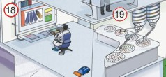
nv
18-19Automation in the laboratory:In the future, research and development activities will make even greater use of complex systems and computer simulations that reach all the way down to the atomic level (18). These will be accompanied by synthesis and analysis processes, particularly with regard to materials development and the life sciences. The results will be lower development costs and a more rapid time-to-market. In a micro-lab (or lab-on-a-chip), for example, robots will be able to conduct thousands of analyses simultaneously (19).

