Slide 1
Revolusi Industri
Muhammad Ary Murti
ITTelkom 2009

Slide 2
Revolusi Industri
The term Industrial Revolution was first popularized by the English economic historian Arnold Toynbee to describe England's economic development from 1760 to 1840.

Slide 3
"An outstanding feature of the Industrial Revolution has been the advance in power technology."

Slide 5
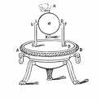
Enabler Technology : “STEAM ENGINE”

Slide 6
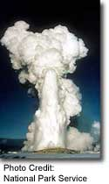

Slide 7
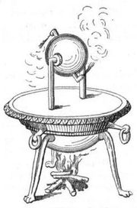
Steam Engine
The history of the steam engine stretches back as far as the first century AD; the first recorded rudimentary steam engine being the aeolipile described by Hero of Alexandria.[3]
In the following centuries, the few engines known about were essentially experimental devices used by inventors to demonstrate the properties of steam, such as the rudimentary steam turbine devices developed by Taqi al-Din[4] in 1551 and Giovanni Branca[5] in 1629.

Slide 8
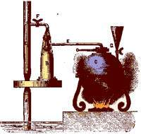
Thomas Savery (1650-1715)
Thomas Savery was an English military engineer and inventor who in 1698, patented the first crude steam engine, based on Denis Papin's Digester or pressure cooker of 1679.

Slide 9
Thomas Savery (1650-1715)
Thomas Savery had been working on solving the problem of pumping water out of coal mines, his machine consisted of a closed vessel filled with water into which steam under pressure was introduced.
This forced the water upwards and out of the mine shaft. Then a cold water sprinkler was used to condense the steam. This created a vacuum which sucked more water out of the mine shaft through a bottom valve.

Slide 10
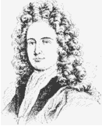
Thomas Savery (1650-1715)
Thomas Savery later worked with Thomas Newcomen on the atmospheric steam engine.
Among Savery's other inventions was an odometer for ships, a device that measured distance traveled

Slide 11
The first commercially-successful engine did not appear until 1712.
Incorporating technologies discovered by Savery and Denis Papin, the atmospheric engine, invented by Thomas Newcomen, paved the way for the Industrial Revolution.
Newcomen's engine was relatively inefficient, and in most cases was only used for pumping water.
It was mainly employed for draining mine workings at depths hitherto impossible, but also for providing a reusable water supply for driving waterwheels at factories sited away from a suitable 'head'.

Slide 12
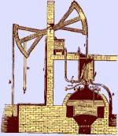
Thomas Newcomen (1663-1729)
Thomas Newcomen was an English blacksmith, who invented the atmospheric steam engine, an improvement over Thomas Slavery's previous

Slide 13
Thomas Newcomen (1663-1729)
The Newcomen steam engine used the force of atmospheric pressure to do the work.
Thomas Newcomen's engine pumped steam into a cylinder. The steam was then condensed by cold water which created a vacuum on the inside of the cylinder. The resulting atmospheric pressure operated a piston, creating downward strokes.
In Newcomen's engine the intensity of pressure was not limited by the pressure of the steam, unlike what Thomas Savery had patented in 1698.

Slide 14
Thomas Newcomen (1663-1729)
In 1712, Thomas Newcomen together with John Calley built their first engine on top of a water filled mine shaft and used it to pump water out of the mine.
The Newcomen engine was the predecessor to the Watt engine and it was one of the most interesting pieces of technology developed during the 1700's

Slide 15
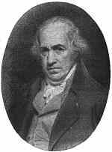
James Watt (1736-1819)
James Watt was a Scottish inventor and mechanical engineer, born in Greenock, who was renowned for his improvements of the steam engine.
In 1765, James Watt while working for the University of Glasgow was assigned the task of repairing a Newcomen engine, which was deemed inefficient but the best steam engine of its time.
That started the inventor to work on several improvements to Newcomen's design.

Slide 16
James Watt (1736-1819)
Most notable was Watt's 1769 patent for a separate condenser connected to a cylinder by a valve.
Unlike Newcomen's engine, Watt's design had a condenser that could be cool while the cylinder was hot.
Watt's engine soon became the dominant design for all modern steam engines and helped bring about the Industrial Revolution.
A unit of power called the Watt was named after James Watt. the Watt symbol is W, and it is equal to 1/746 of a horsepower, or one Volt times one Amp.

Slide 17
James Watt (1736-1819)
Watt's engine used 75% less coal than Newcomen's, and was hence much cheaper to run.
Watt proceeded to develop his engine further, modifying it to provide a rotary motion suitable for driving factory machinery.
This enabled factories to be sited away from rivers, and further accelerated the pace of the Industrial Revolution.

Slide 18
Around 1800, Richard Trevithick introduced engines using high-pressure steam.
These were much more powerful than previous engines and could be made small enough for transport applications.
Thereafter, technological developments and improvements in manufacturing techniques (partly brought about by the adoption of the steam engine as a power source) resulted in the design of more efficient engines that could be smaller, faster, or more powerful, depending on the intended application

Slide 19
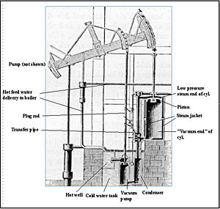

Slide 20
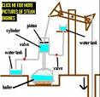
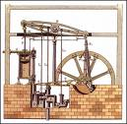

Slide 22
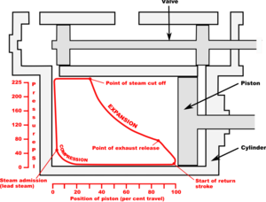

Slide 23
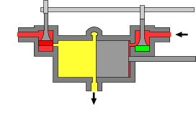

Slide 24
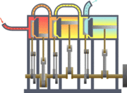

Slide 25
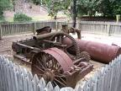

Slide 26
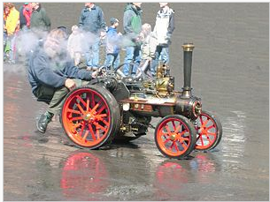
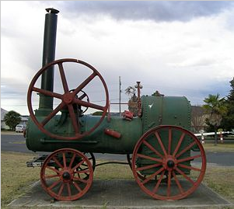

Slide 27
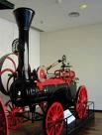
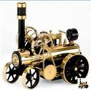

Slide 28
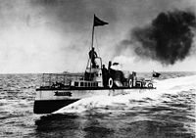

Slide 30
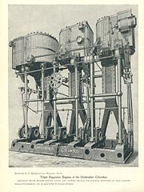

Slide 31
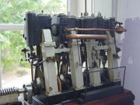

Slide 32
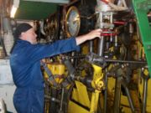

Slide 33
Power Plant

Slide 34
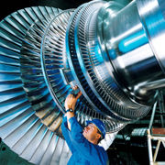

Slide 35
Steam engines remained the dominant source of power well into the 20th century, when advances in the design of electric motors and internal combustion engines gradually resulted in the vast majority of reciprocating steam engines being replaced in commercial usage, and the ascendency of steam turbines in power generation.

Slide 36
Teknologi yang ada saat ini merupakan suatu proses pengembangan Teknologi yang berkisambungan

